Slide 1
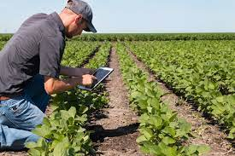
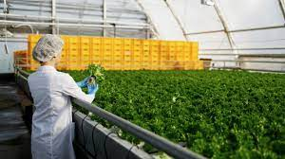
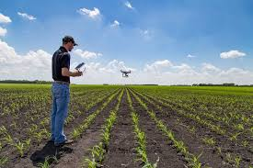
This week’s career of the week is…..
Agronomist

Slide 2
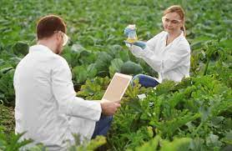
What is it??
Sometimes also called a crop scientist, agricultural consultant or agronomy manager, agronomists advise farmers on soil health, disease prevention and how to improve crop production and quality.

Slide 3
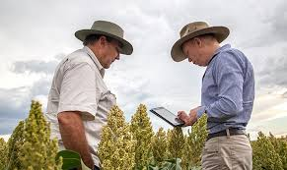
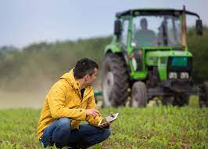
Where could I work?
You could work in an office, on a farm, at a research facility or visit sites.
Your working environment may be outdoors some of the time and you'll travel often.

Slide 4
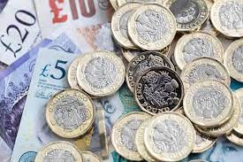
How Much Could I Earn?
Typical salary starts at £22, 500
This can increase to £60, 000 per year for more experienced workers.
Usually you would be working between 37 and 40 hours per week, mostly on a weekday.
This is a ‘green career’- due to the interest and importance of preserving our environment and living sustainably, this career has good prospects and there will likely be more job vacancies and an increase in average wage for this career in the future.

Slide 5
What qualifications would I need?
You could go to university and study for a degree in:
agriculture
biology
crop and plant science
ecology
environmental science
Some employers may also look for relevant postgraduate qualifications (a qualification after getting a degree) in subjects like:
soil science
genetics
crop technology
You will need between 2 to 3 ‘A’-Levels to study one of these courses at university.

Slide 6
Or you could study at college
You could get relevant skills and knowledge by taking a course like:
Level 3 Extended Diploma in Agriculture
T Level in Agriculture, Land Management and Production
Courses like these can help you move on to further training at university or an apprenticeship. To get onto one of these courses you would normally need 4 or 5 GCSE’s at Grade 9- 4.

Slide 7
Or you could do an apprenticeship and earn while you learn
You could start your career by doing an Agriculture Professional Adviser Level 6 Higher Apprenticeship.
This apprenticeship can take up to 3 years to complete.
Most people following this route have
4 or 5 GCSEs at grades 9 to 4 and A levels, or equivalent, for a higher or degree apprenticeship and some experience in related work.

Slide 8
Or
You could study for the BASIS Foundation Award in Agronomy if you're new to the industry and have limited crop experience and knowledge. This will give you an introduction to agronomy, crop protection and crop nutrition.

Slide 9
What would you spend your days doing as an agronomist?
In your day-to-day duties you may:
advise farmers on land management and how to improve crop yields
study soil, fertilisers and other factors which affect crop growth
create chemical, biological and organic treatment plans to promote healthy crops
carry out field trials to solve clients' crop problems
use new technology such as drones and AI to track plant growth and changes in environmental conditions

Slide 10
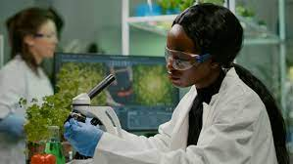
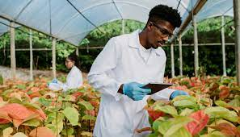
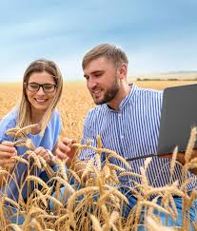
So what do agronomists do?
https://www.youtube.com/watch?v=9WCqEa39KDY

