Slide 1
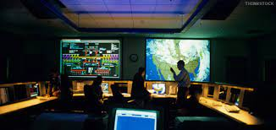
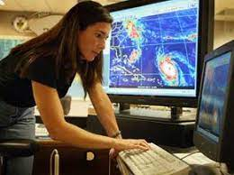
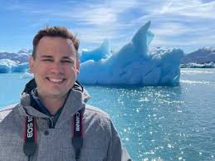
This week’s career of the week is…..
Meteorologist

Slide 2
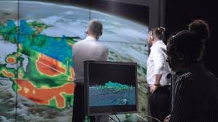
What is it??
Meteorologists collect and study data from the atmosphere and oceans to make weather forecasts and carry out research.

Slide 3
Employers of Meteorologists
The largest employer of meteorologists in the UK is the Met Office. It incorporates the Met Office Hadley Centre, a world-renowned centre for advanced climate modelling and monitoring.
Most employees are based at the Met Office's headquarters in Exeter, or their twin operational centre in Aberdeen, but there are many smaller offices and remote centres across the country - as well as overseas locations including Africa, the South Atlantic and the Antarctic.
A subsidiary of the Met Office is the Mobile Met Unit (MMU), whose staff are attached to Royal Air Force (RAF) units and may be employed throughout the world on both military exercises and operations.

Slide 4
Where else could I work?
You'll typically specialise in either weather forecasting or research. In forecasting, you can provide weather predictions for a variety of organisations including:
the aviation industry
farmers
government services, e.g. for advice on climate change policy
health services
industry and retail businesses
insurance companies
public services
sailing organisations and offshore companies
the armed forces
the media
the shipping and sea fishing industries.
Within research through a university, you could study the impact of weather on the environment and conduct research into weather patterns, climate change and models of weather prediction.

Slide 5
How Much Could I Earn?
Salaries start at £26,954.
Experienced and senior meteorologists can expect to earn salaries between £36,000 and £42,000.
Expert meteorologists and those in managerial positions earn from £38,000 to over £60,000.

Slide 6
What qualifications would I need?
To become a meteorologist you must have a degree. Most commonly this will be meteorology, maths or physics, but some graduates begin their careers with other accepted subjects, such as:
computing/computer science
data science
electronics
environmental sciences
ocean science
physical geography
physical sciences
software engineering.
You'll usually need:
4 or 5 GCSEs at grades 9 to 4 including English, maths and science
2 or 3 A levels, or equivalent, including a science, for a degree.

Slide 7
What Skills Would You Need?
You'll need to show:
mathematical and computing ability
good problem-solving skills
attention to detail and accuracy
ability to write scientific reports
a team-orientated approach to work
the ability to interact with a range of people
enthusiasm and a genuine interest in meteorology and the environment.

Slide 8
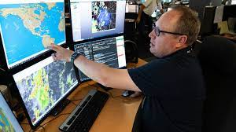
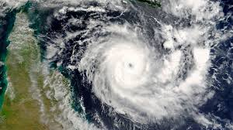
So what do meteorologists do?
https://www.youtube.com/watch?v=HaJkx-sVY68

